Slide 1
In the Classroom
Learner Profile
Teacher Interview
Peer Interviews
Interview Planning Questionnaire
Student sign-up sheet

Slide 2
6) Ethnographic Interview Questions 7) Role Playing Questions 8) Guest Speaker Interviews 9) Options for Interviews: Audio, Skype and Email 10) Questions for Reflection

Slide 3
1. Learner Profile

Slide 4
2. Teacher Interview
1) Where is your hometown?
2) Where do you live now?
3) How long have you lived in
Japan?
4) Can you speak Japanese
fluently?
5) What other language(s) can
you speak?
6) What subjects did you major
in at university?
7) Why did you decide to become
an English teacher?
8) Which countries have you visited?
9) Can I send you email if I have a question?

Slide 5
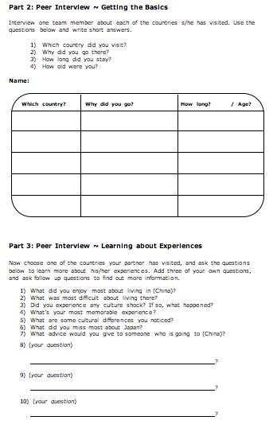
3. Peer Interviews

Slide 6
4. Interview Planning Questionnaire

Slide 7
5. Interview Sign-up Sheet

Slide 8
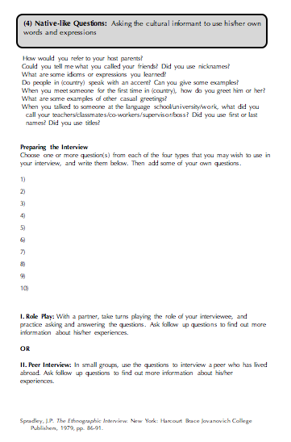
6. Ethnographic Interview Questions

Slide 9
7. Role Playing Questions

Slide 10
8. Guest Speaker Interviews
Teacher preparation for the visit
Telephone calls, visits
Website information, brochures (e.g. “Second
Harvest Japan ~ Japan’s First Food Bank”)
Articles posted on teacher’s website
Class watches videos, discuss articles
Students prepare questions for guest speaker
Teacher and students role play interview

Slide 11
8. Guest Speaker Interview with Dr. Rumi Ida, Project Coordinator for 2nd Harvest Japan
1
1) When and why was Second Harvest established? 3) Where does the name come from?
2) How many countries have a Second Harvest organization? 4) What are 2HJ’s main objectives?

Slide 12
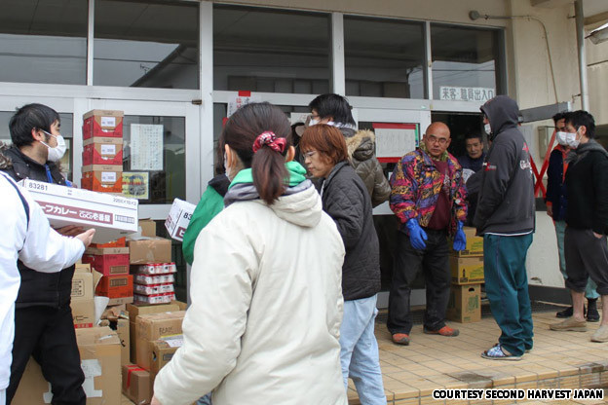
8. Guest Speaker Interview ~ 2nd Harvest Japan
5) What motivated you to start 2HJ?
6) What was the biggest obstacle that you had to overcome?
7) Is Japanese speaking ability necessary?
8) What has 2HJ done to help people since it was founded?
9) How many volunteers are there at 2HJ?
10) What kind of people volunteer at 2HJ?
11) How often do people work or volunteer at 2HJ?
12) What do we need to do if we want to participate in the soup kitchen?
13) What do volunteers at 2HJ do besides the soup kitchen?
How do you obtain funding for 2HJ?
http://www.2hj.org

Slide 13
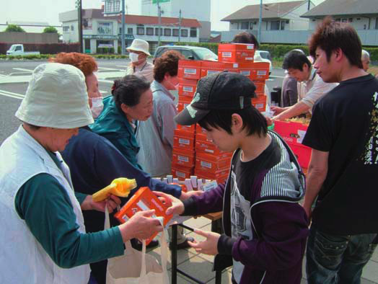
8. Guest Speaker Interview ~ 2nd Harvest Japan
15) How much does it cost to cover annual expenses?
16) To what areas of Japan does 2HJ mainly distribute food?
17) When did you decide to go to Tohoku?
18) How did you reach survivors? Wasn’t it dangerous?
19) What is most needed in Tohoku right now?
20) What kind of food do you provide for people?
21) Does 2HJ receive food everyday?
Are you able to use all of the food that 2HJ receives?
23) What are your plans for the future of 2HJ?

Slide 14
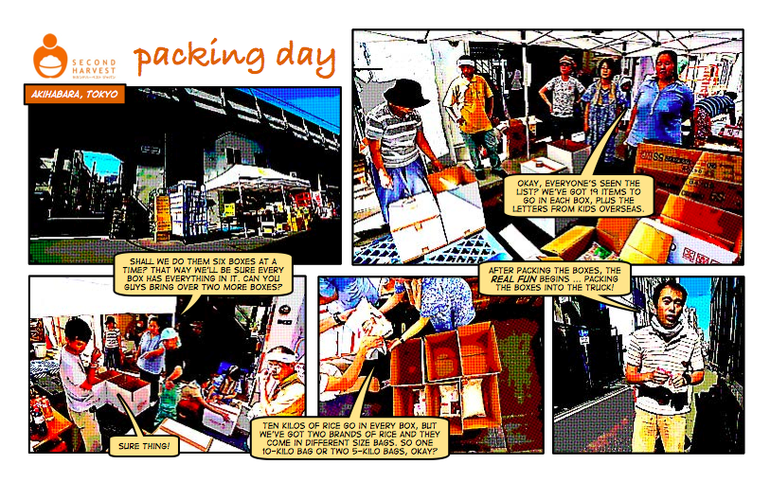
8. Guest Speaker Interview ~ 2nd Harvest Japan

Slide 15
9. E-mail Option
Facilitates process of finding an interviewee
Simplifies scheduling & logistics
Allows for multiple contacts with interviewee
Reduces impact of time constraints
Facilitates comprehension, clarification & confirmation
Simplifies communication of detailed information
Provides transcription of interview
(Students may choose to use a separate email account.)

Slide 16
9. Audio Recording Options
…on iPad or iPhone or iPod touch
Dragon Dictation

Slide 17
9. Audio Recording Options
…for Android
…coming soon?

Slide 18
9. Skype Video Options
Vodburner for Windows
IMCapture for Mac / Windows
Transcribing Interviews

Slide 19
10. Questions for Reflection
Did you agree or disagree with any
points made by the interviewee?
Could you relate to his/her experiences?
What did you learn about another
culture?
Did you gain any insights into Japanese culture?
What did you learn from doing the
interview?
“I was very surprised to know about
college students in Canada. In Japan,
most people go to college before
getting jobs, and colleges in Japan
are places to prepare for going out
Into society. However, in Canada, the
half of Canadian work before going
to colleges, and the other half go to
colleges directly.”

