Slide 1
In the Classroom
Learner Profile
Teacher Interview
Peer Interviews
Interview Planning Questionnaire
Student sign-up sheet
Notes:
Sev tasks in this section involve various handouts and worksheets > copies avail. or can req via email

Slide 2
6) Ethnographic Interview
Questions
7) Role Playing Questions
8) Guest Speaker Interviews
9) Options for Interviews:
Audio, Skype and Email
10) Questions for Reflection
Notes:
Purpose of the tasks is to provide scaffolding to build ss’ confidence and provide opps to practice doing interviews in a structured environment. There are various int format for doing the int. Following the interview project, ss reflect on their experiences.

Slide 3
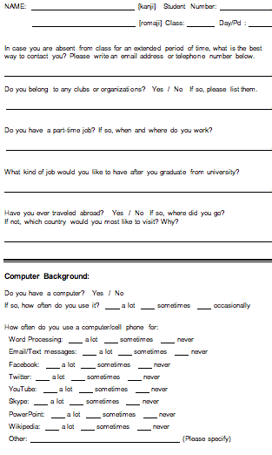

1. Learner Profile
Notes:
On the 1st day of class,… and they write 2 Qs to ask me.

Slide 4
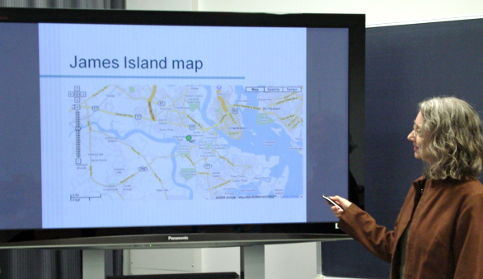
2. Teacher Interview
1) Where is your hometown?
2) Where do you live now?
3) How long have you lived in
Japan?
4) Can you speak Japanese
fluently?
5) What other language(s) can
you speak?
6) What subjects did you major
in at university?
7) Why did you decide to become
an English teacher?
8) Which countries have you visited?
9) Can I send you email if I have a question?
Notes:
In the 2nd or 3rd class, I give ss a list of their Qs and we do their 1st in w/ a NES. Using a slideshow also provides a kind of sample demo of the PPt pres they’ll be doing about their interview project.

Slide 5
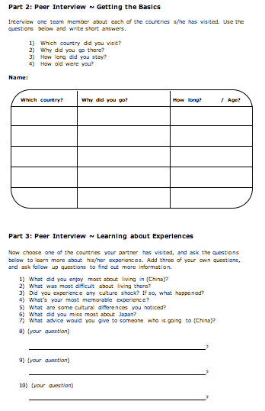
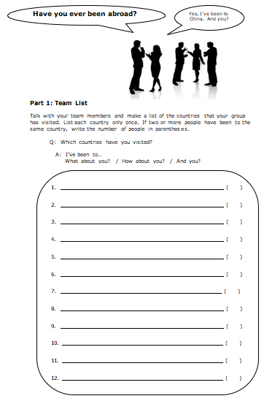
3. Peer Interviews
Notes:
Also in 1st or 2nd class, ss do peer ints about their classmates’ exps. abroad. First, in grps of 3 or 4, ss make a list of all the countries the membs in their grp have visited. Then they do two peer ints to learn more.

Slide 6
4. Interview Planning Questionnaire
Notes:
A week after introducing the int proj to ss, they receive an int planning Q and are asked to complete it in 2 wks. They decide whether they’ll work w/ a partner, who they will int, when and where to do the int, what format to use. The form also makes it easy for them to ask any Qs they may have abt doing the int. and has proved valuable in trouble shooting.

Slide 7

5. Interview Sign-up Sheet
Notes:
A week after introducing the int proj to ss, they receive an int planning Q and are asked to complete it in 2 wks. They decide whether they’ll work w/ a partner, who they will int, when and where to do the int, what format to use. The form also makes it easy for them to ask any Qs they may have abt doing the int. and has proved valuable in trouble shooting.

Slide 8
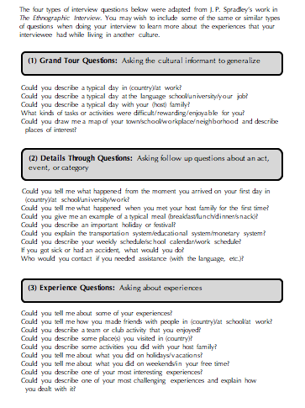
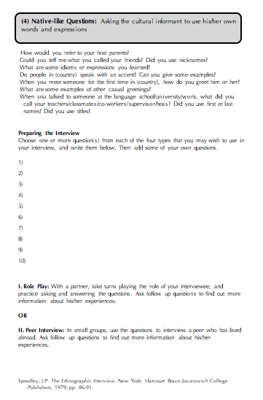
6. Ethnographic Interview Questions
Notes:
When ss have selected an interviewee, they and their partner create the Qs they’ll use for the int. This list of ethno int Qs provides a template for them to draw from, adapting Qs to fit the context of their int. and adding other Qs of their own. After selecting the Qs for their ints, ss do a role play, taking turns playing the role of their interviewee w/ their partner doing the int. Ss can also use their int Qs to do more in-depth peer ints.

Slide 9

7. Role Playing Questions
Notes:
A week after introducing the int proj to ss, they receive an int planning Q and are asked to complete it in 2 wks. They decide whether they’ll work w/ a partner, who they will int, when and where to do the int, what format to use. The form also makes it easy for them to ask any Qs they may have abt doing the int. and has proved valuable in trouble shooting.

Slide 10

8. Guest Speaker Interviews
Teacher preparation for the visit
Telephone calls, visits
Website information, brochures (e.g. “Second
Harvest Japan ~ Japan’s First Food Bank”)
Articles posted on teacher’s website
Class watches videos, discuss articles
Students prepare questions for guest speaker
Teacher and students role play interview
Notes:
A final step in preparation for doing the int proj is to int a guest spkr in class. Currently in the process of arranging for a gst spkr from 2HJ… info and video on website, CNN, arts. and newsletters (circ. Info).

Slide 11


8. Guest Speaker Interview with Dr. Rumi Ida,
Project Coordinator for 2nd Harvest Japan
1
1) When and why was Second Harvest established? 3) Where does the name come from?
2) How many countries have a Second Harvest organization? 4) What are 2HJ’s main objectives?
Notes:
After reading and discussing info abt the org and watching a couple of videos online, ss wrote int Qs. We’ll role play some of the Qs in class. Then during the int., ea st will ask the gst spkr their Q. Ss will also have a chance to ask f/u Qs after the int.

Slide 12

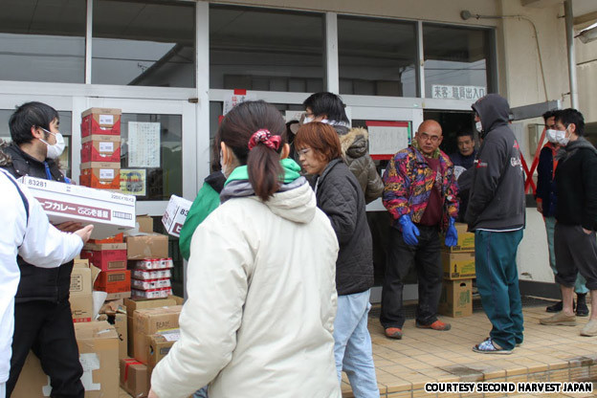

8. Guest Speaker Interview ~ 2nd Harvest Japan
5) What motivated you to start 2HJ?
6) What was the biggest obstacle that you had to overcome?
7) Is Japanese speaking ability necessary?
8) What has 2HJ done to help people since it was founded?
9) How many volunteers are there at 2HJ?
10) What kind of people volunteer at 2HJ?
11) How often do people work or volunteer at 2HJ?
12) What do we need to do if we want to participate in the soup kitchen?
13) What do volunteers at 2HJ do besides the soup kitchen?
How do you obtain funding for 2HJ?
http://www.2hj.org
Notes:
After reading and discussing info abt the org and watching a couple of videos online, ss wrote int Qs. We’ll role play some of the Qs in class. Then during the int., ea st will ask the gst spkr their Q. Ss will also have a chance to ask f/u Qs after the int.

Slide 13

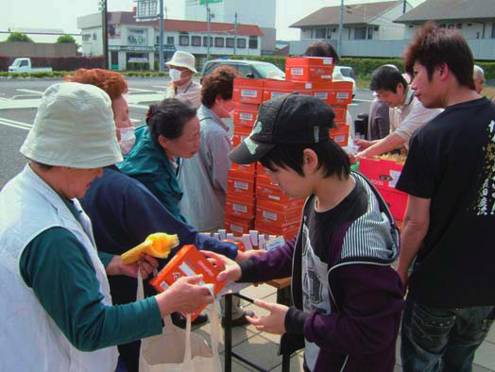
8. Guest Speaker Interview ~ 2nd Harvest Japan
15) How much does it cost to cover annual expenses?
16) To what areas of Japan does 2HJ mainly distribute food?
17) When did you decide to go to Tohoku?
18) How did you reach survivors? Wasn’t it dangerous?
19) What is most needed in Tohoku right now?
20) What kind of food do you provide for people?
21) Does 2HJ receive food everyday?
Are you able to use all of the food that 2HJ receives?
23) What are your plans for the future of 2HJ?
Notes:
After reading and discussing info abt the org and watching a couple of videos online, ss wrote int Qs. We’ll role play some of the Qs in class. Then during the int., ea st will ask the gst spkr their Q. Ss will also have a chance to ask f/u Qs after the int.

Slide 14

8. Guest Speaker Interview ~ 2nd Harvest Japan
Notes:
After reading and discussing info abt the org and watching a couple of videos online, ss wrote int Qs. We’ll role play some of the Qs in class. Then during the int., ea st will ask the gst spkr their Q. Ss will also have a chance to ask f/u Qs after the int.

Slide 15
9. E-mail Option
Facilitates process of finding an interviewee
Simplifies scheduling & logistics
Allows for multiple contacts with interviewee
Reduces impact of time constraints
Facilitates comprehension, clarification & confirmation
Simplifies communication of detailed information
Provides transcription of interview
(Students may choose to use a separate email account.)
Notes:
Init, I discouraged ss from doing ints. via email, but there are certain/some benefits. Using email… Here’s an excerpt from an int that a st did last semester. There were 27 email exchanges b/w the two. In reading over the pages of text, it seemed clear that, had they done the int in person, it would have taken a couple of hours to cover all the info. That’s 5 to 10 times longer than most ss spend doing their ints. As w/ Skype, allows for ongoing comm after the int.

Slide 16

9. Audio Recording Options
…on iPad or iPhone or iPod touch
Dragon Dictation
Notes:
The newest app of DD makes it simple to make an audio recording on iPad or iPhone and automatically generate a transcript of the conversation.

Slide 17

9. Audio Recording Options
…for Android
…coming soon?
Notes:
The newest app of DD makes it simple to make an audio recording on iPad or iPhone and automatically generate a transcript of the conversation.

Slide 18
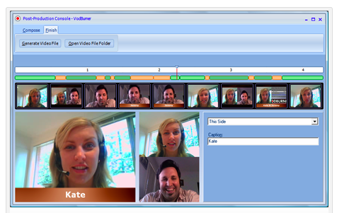
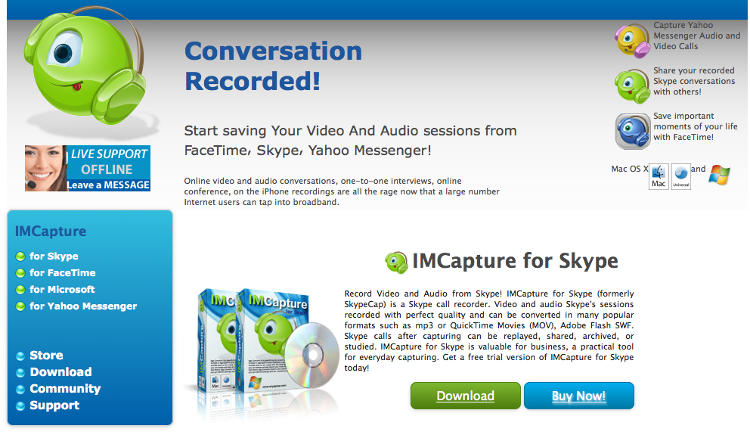
9. Skype Video Options
Vodburner for Windows
IMCapture for Mac / Windows
Transcribing Interviews
Notes:
Skype provides a very easy option for ss to int a NES via Int for free, and software apps allow them to record their ints. Skype also offers the poss of on going comm following the int.

Slide 19
10. Questions for Reflection
Did you agree or disagree with any
points made by the interviewee?
Could you relate to his/her experiences?
What did you learn about another
culture?
Did you gain any insights into Japanese culture?
What did you learn from doing the
interview?
“I was very surprised to know about
college students in Canada. In Japan,
most people go to college before
getting jobs, and colleges in Japan
are places to prepare for going out
Into society. However, in Canada, the
half of Canadian work before going
to colleges, and the other half go to
colleges directly.”
Notes:
Following the int., ss reflect on their experience doing the proj. through journal writing.

